Slide 1

Housing Affordability
Melbourne

Slide 2

Objective: Analyze the factors affecting Housing Affordability in Melbourne
Table of contents:
Factors affecting :
Population-Presenter Hansen
Salary-Aria
School Ranking-Rakhi
Inflation/Interest Rates-Mark

Slide 3
Data Sources | Data Preparation | Analysis

Slide 4
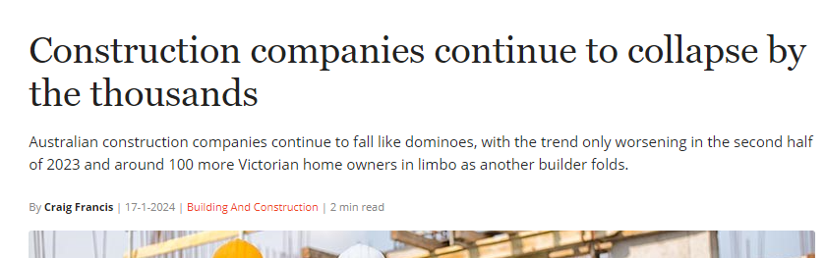
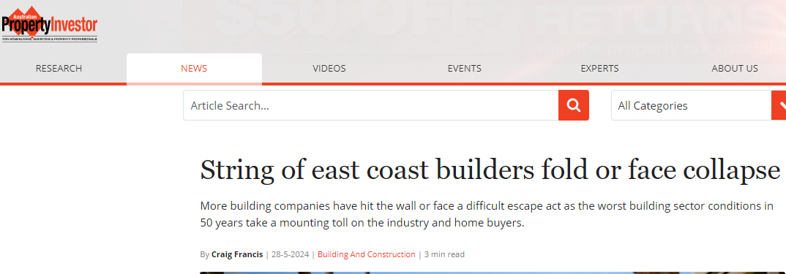
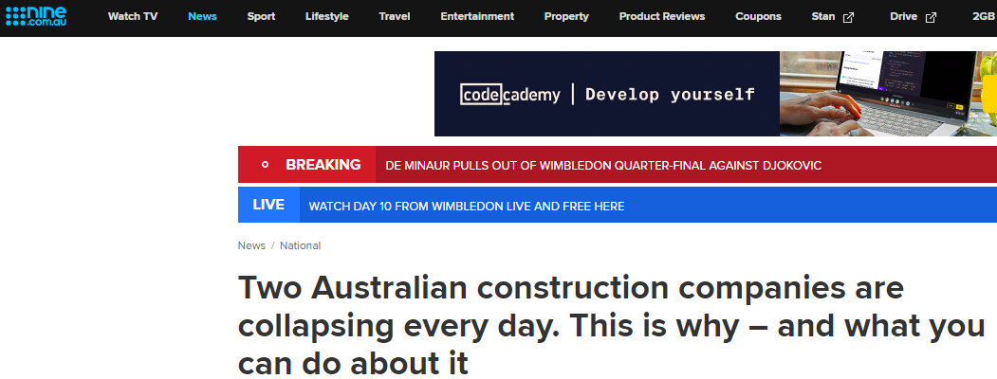

Slide 5
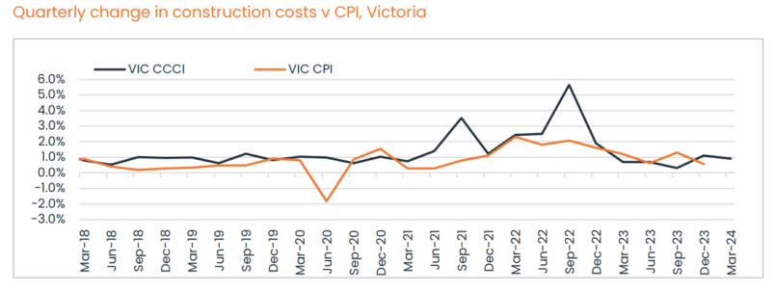
https://propertyupdate.com.au/how-much-on-average-does-it-cost-to-build-a-house/#building-costs-growth-forecast-for-the-year-ahead
Analysis of Melbourne's Housing Crisis: Rising Costs (Inflation), and Interest Rates and Household Debt to Income (2013-2023)
The recent string of construction company collapses in Melbourne has exacerbated the housing crisis by reducing supply and increasing building costs, which have surpassed the Consumer Price Index (CPI). Additionally, high interest rates are making home purchases more difficult and putting pressure on rental properties.
This analysis examines these factors within the context of Melbourne from 2013 to 2023, utilizing a dataset that includes detailed information on house prices, interest rates, and inflation. The study involves data cleaning, exploration, analysis, and visualization to uncover trends and relationships.
Housing Prices and Interest Rates Analysis
The first analysis focuses on identifying the relationship between interest rates and median house prices across Melbourne suburbs from 2013 to 2023. Given the positive skewness of the data (average skewness of 2), it is clear that house prices are heavily influenced by a few high-value properties.
From 2019 to 2023, there are over 30 categories of interest rates (e.g., fixed, variable, investor) provided by the Reserve Bank of Australia (RBA). Historically, these rates do not differ significantly from each other. For instance, the standard variable rate for CBA is 7.14%, compared to a fixed rate of 6.59%. Due to the difficulty in categorizing specific interest rate buckets, we use the average interest rate for a fair assessment. The data, collected at specific dates, represents an average of variable and fixed rates sourced from RBA websites due to data unavailability.
Statistical Analysis
The statistical analysis, particularly focusing on the p-value, shows that the p-value is nearly zero. This indicates a very low probability that the observed differences between interest rates and house prices happened by chance. Consequently, there is strong evidence to reject the null hypothesis, confirming a statistically significant difference between the means of the two datasets. Conclusion
The analysis concludes that high interest rates contribute significantly to the rise in house prices. This relationship, combined with the impact of collapsing construction companies and rising building costs, underscores the complexity of Melbourne's housing crisis. Addressing these issues requires a multifaceted approach, considering both financial and structural factors influencing the housing market.

Slide 6
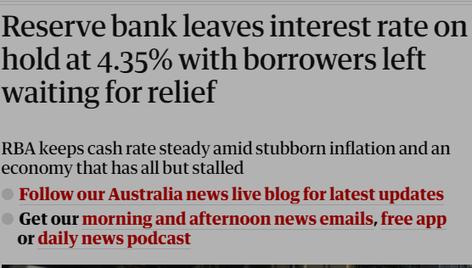
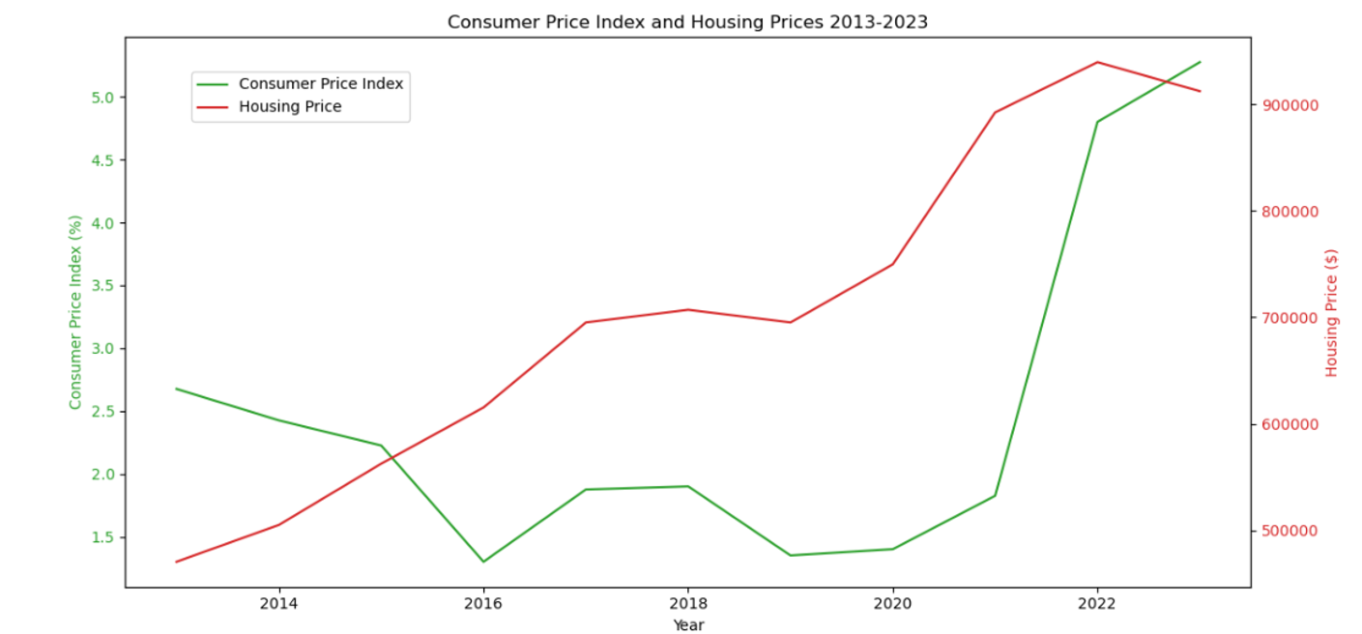
Anticipation for the RBA Cash Rate Decision and Its Impact on Melbourne's Housing Market
On the upcoming 6th of August 2024, at 2:30 PM, Australians are eagerly awaiting the Reserve Bank of Australia's (RBA) decision on the cash rate, which is largely influenced by the inflation rate, also known as the Consumer Price Index (CPI). A 0.5% increase in the cash rate would result in the average Melburnian with a mortgage of $1,000,000 (median house price in 2023 was $912,255) needing to divert $300 per month from their family holiday budget to cover the additional interest costs.
Analysis of Inflation Trends
The average inflation rate in Australia has shown a steady increase from 2.6% in 2013 to 5.275% in 2023. This rising trend in inflation is a critical factor considered by the RBA when setting the cash rate.
Statistical Analysis of Inflation and Housing Prices
Pearson Correlation
The Pearson correlation coefficient between year-ended weighted median inflation and housing prices is 0.495. This value suggests a moderate positive linear relationship, meaning that as inflation increases, housing prices tend to increase as well.
P-value
The p-value associated with this correlation is 0.122. Since this p-value is greater than the common significance threshold of 0.05, we fail to reject the null hypothesis at the 5% significance level. This indicates that there is not enough statistical evidence to conclude that the observed correlation between inflation and housing prices is significantly different from zero.
Conclusion
In conclusion, while there is a moderate positive correlation between inflation (CPI) and housing prices, the statistical evidence is not strong enough to definitively state that CPI significantly contributes to the housing price crisis in Melbourne. The upcoming RBA decision on the cash rate, influenced by rising inflation, will have a direct impact on mortgage costs for Melburnians, highlighting the complex interplay between economic factors and the housing market.

Slide 7
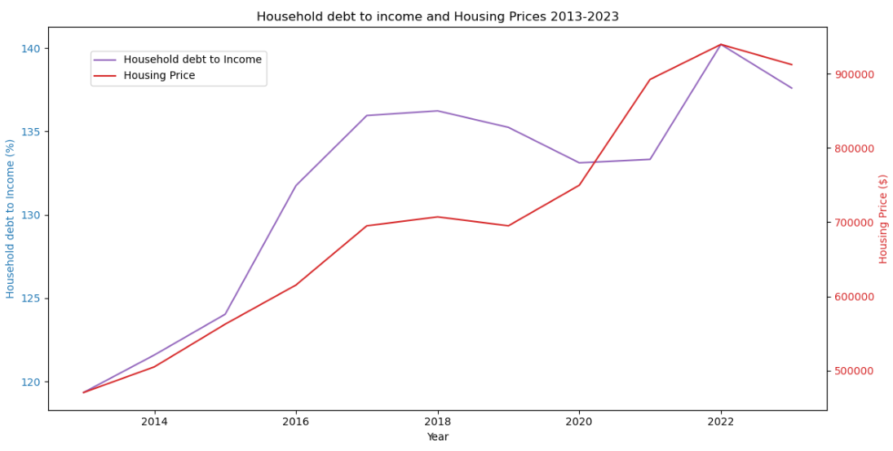
Household debt to income
Statistical Analysis of Household Debt to Housing Price
Pearson Correlation
The Pearson correlation coefficient between household debt and housing prices is 0.858. This value indicates a very strong positive linear relationship between the two variables, meaning that as household debt increases, housing prices also tend to increase significantly.
P-value
The p-value associated with this correlation is 4.79×10−84.79 \times 10^{-8}4.79×10−8, which is much less than the common significance threshold of 0.05. This indicates that the observed correlation is statistically significant. There is strong evidence to reject the null hypothesis, which states that there is no relationship between household debt and housing prices. Therefore, the observed strong positive correlation is very unlikely to be due to random chance.

Slide 8
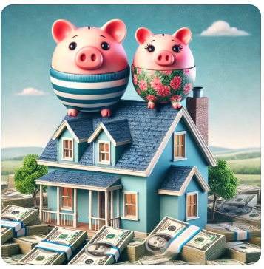
There is hope

